Slide 1

Diagnosing Subsurface Vertical Velocities in Mesoscale Eddies Using Satellite Altimetry Data
Faizan Haque,
Professor François Primeau

Slide 2
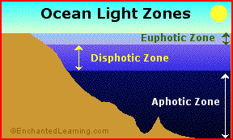
Goal: Quantify Vertical Velocities and Impact on Phytoplankton
Photosynthesis requires balance of sunlight and nutrients
Euphotic zone is nutrient limited
Upwelling can bring nutrients from Disphotic Zone to the euphotic Zone
Notes:
Needs source

Slide 3
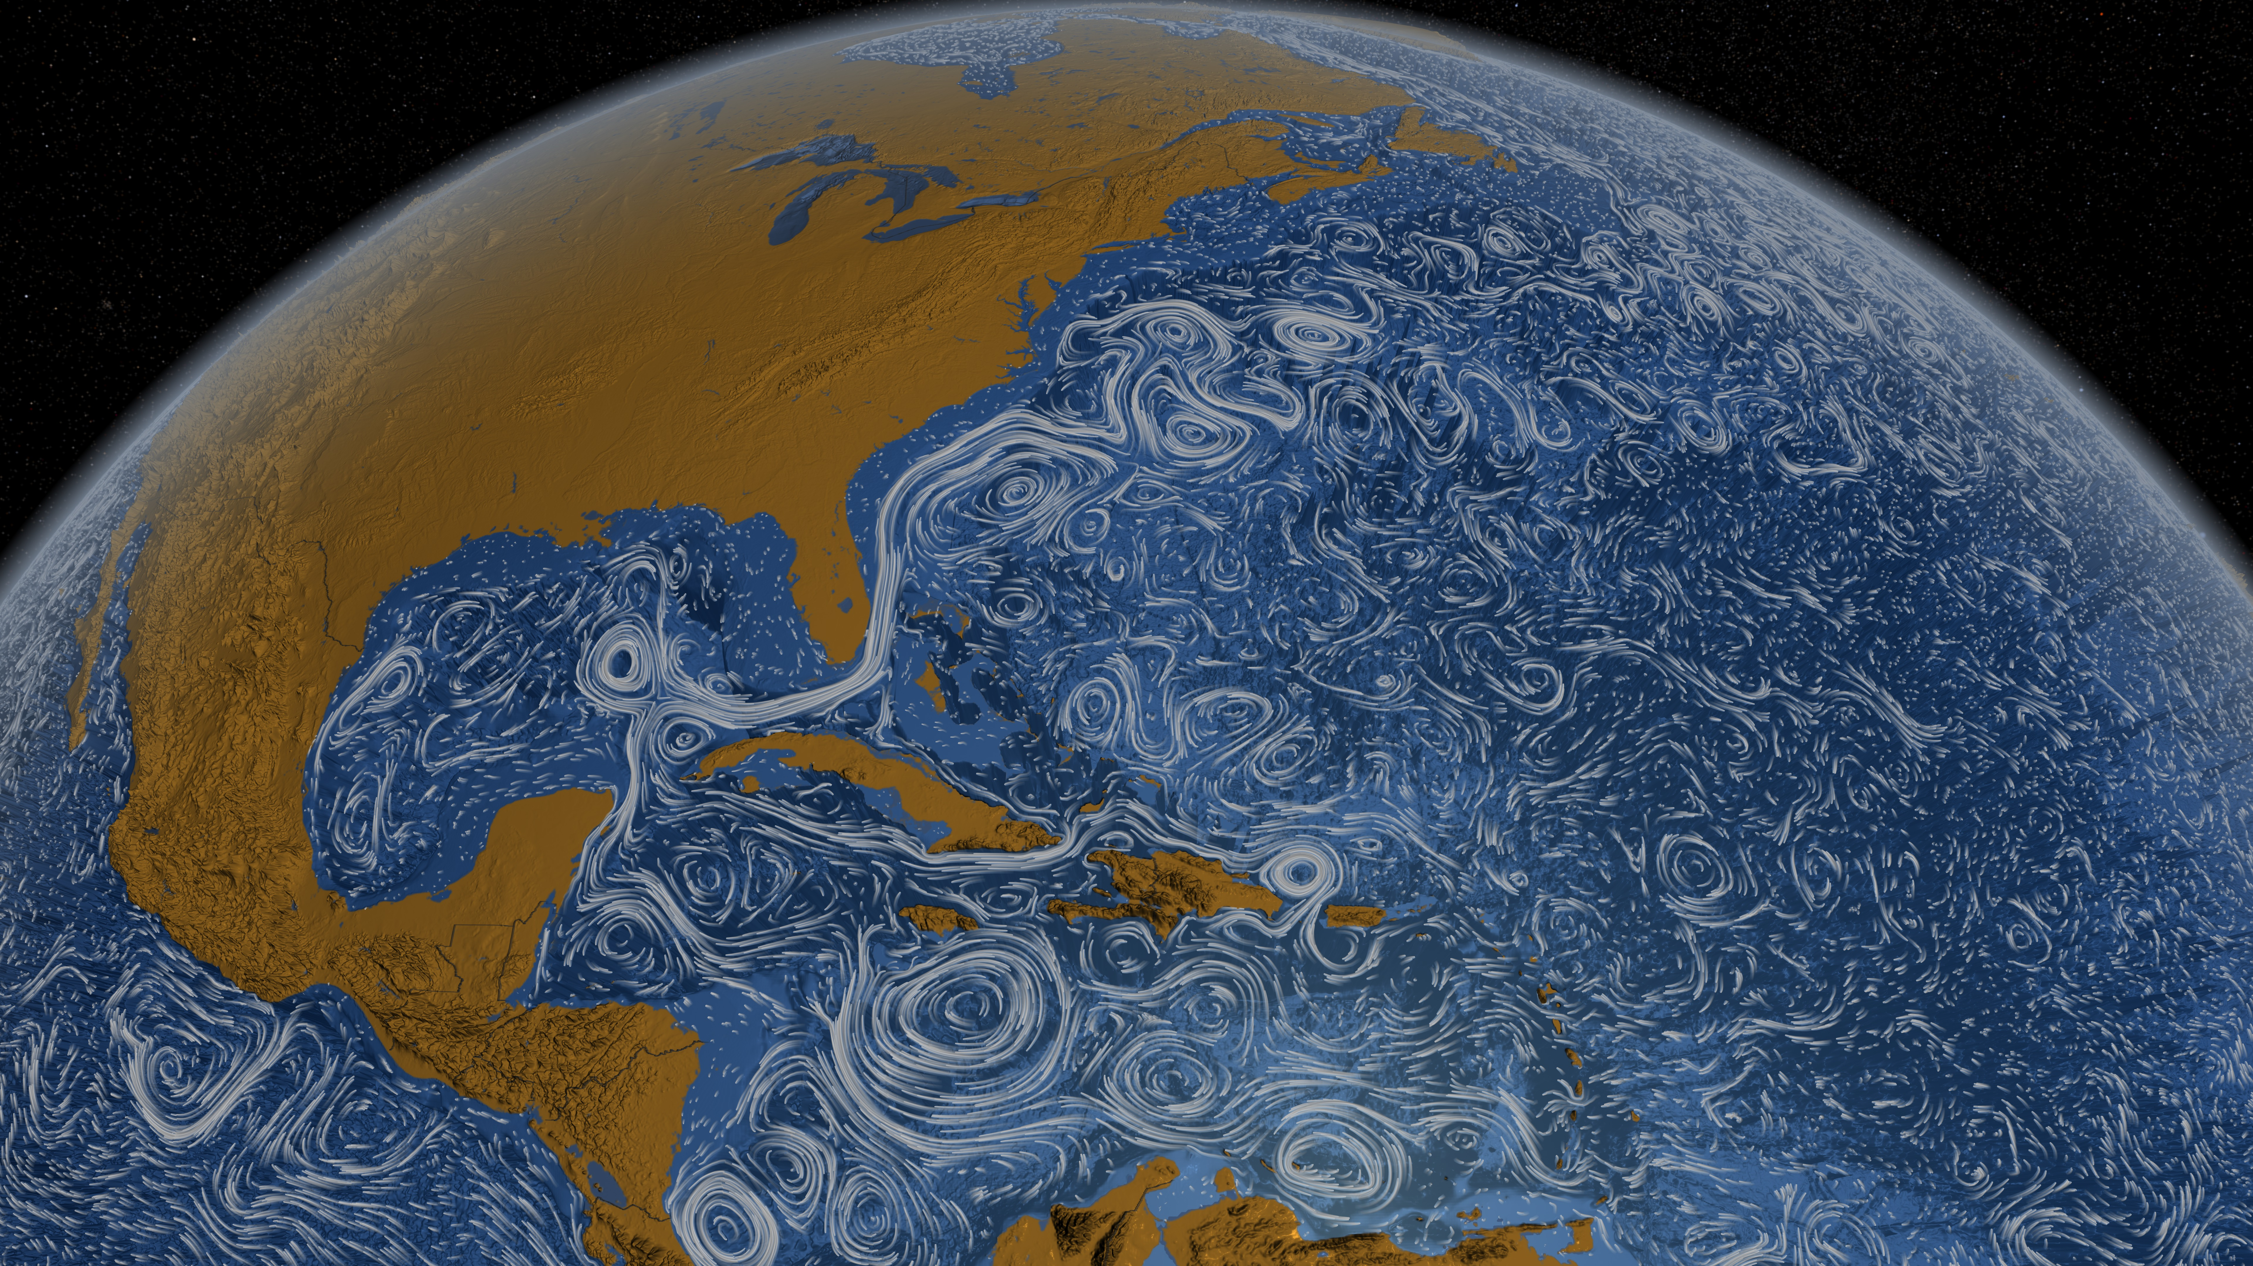
What are mesoscale eddies and why are they important?
Notes:
- Mesoscale eddies are these swirly things where
- 10 km - 200 km in size
- Lifetime of about weeks to months
- Horizontal velocities are of order 0.1 m/s to 10 m/s
- Vertical velocities are of order 1 m/day to 10m/day
- Too small to directly measure
- Vertical velocities occur most intensely at edges of eddies and fronts
-
Point out we are looking at this region

Slide 4
Data Collection in Oceanography
Ship Cruises:
Pro: Can collect data from deeper parts of ocean
Con: Logistically difficult
Con: Cannot collect simultaneous data
Argo floats:
Pro: Larger number of data points
Con: Not uniform
Con: Not simultaneous
Satellites:
Pro: Spatially uniform and at regular time intervals
Con: Can measure only the surface
Notes:
I get the data from an online database in a nice dataset
There are three main ways, and what’s important is that it’s very difficult to directly measure vertical velocities using these

Slide 5
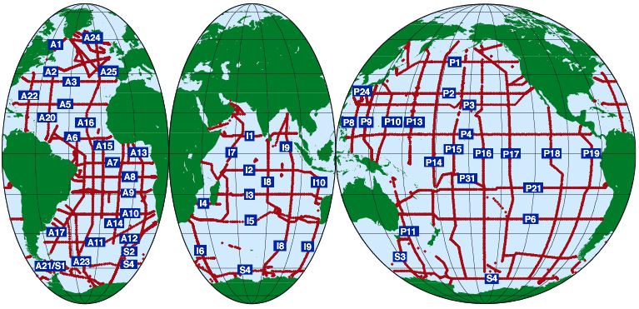
Ships
Notes:
Insert source
Logistically difficult to sample the entire global surface, and it takes more than a decade to conduct a global survey and most of the ocean is not being covered

Slide 6
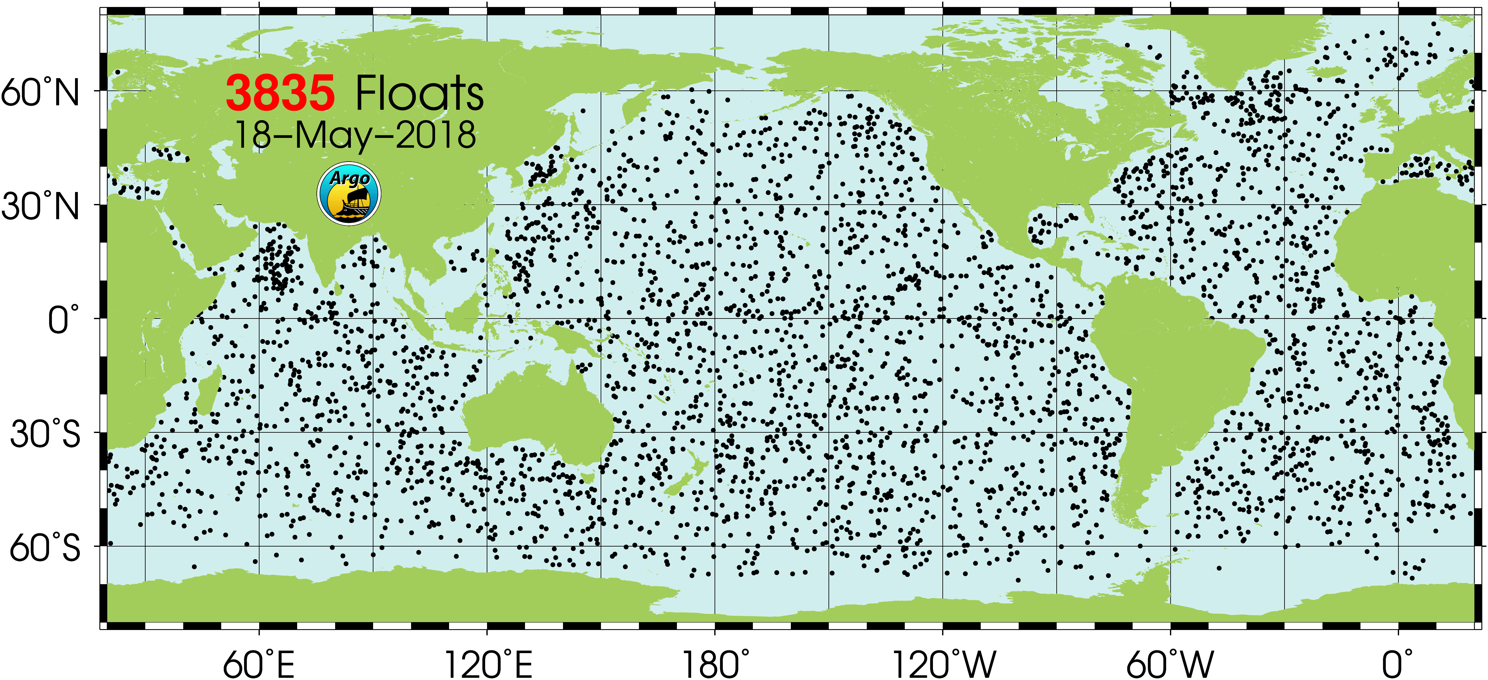
Argo Floats
Notes:
- Insert source

Slide 7
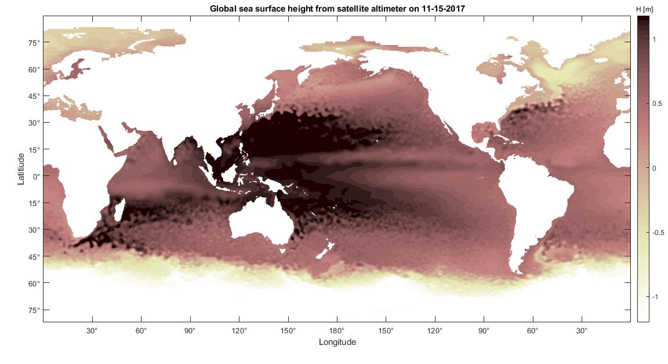
Satellites

Slide 8
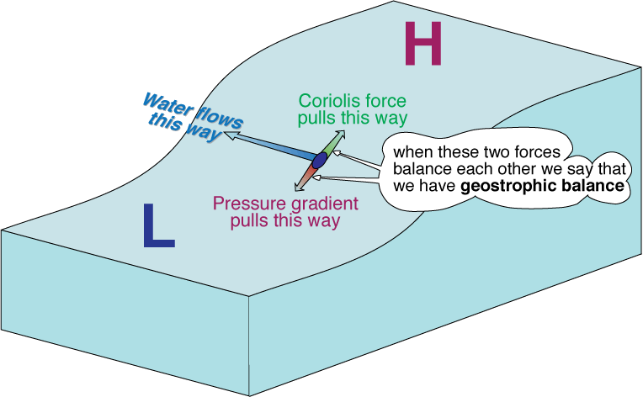
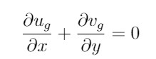
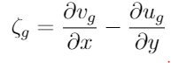
Quasi-Geostrophy
Geostrophy:
Pressure Gradient Force = Coriolis Force
Geostrophic Velocity:
Divergenceless
Geostrophic Vorticity:
Quasi-Geostrophy:
Pressure Gradient Force~ Coriolis
Gravity has a small role

Slide 9
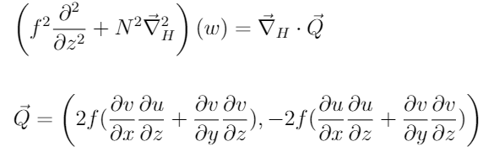
Diagnosing Vertical Velocities: Quasi-geostrophic Omega Equation
Given u, v, T and S data
We solve for w
x,y,z are the cartesian
coordinates
u,v are horizontal currents
provided by satellites
f is the Coriolis parameter, which is frequency of the vertical component of the rotation of the earth
N² is the buoyancy frequency, which is the rate at which a blob of fluid would oscillate if displaced vertically
Notes:
Fix equation
Add citations

Slide 10
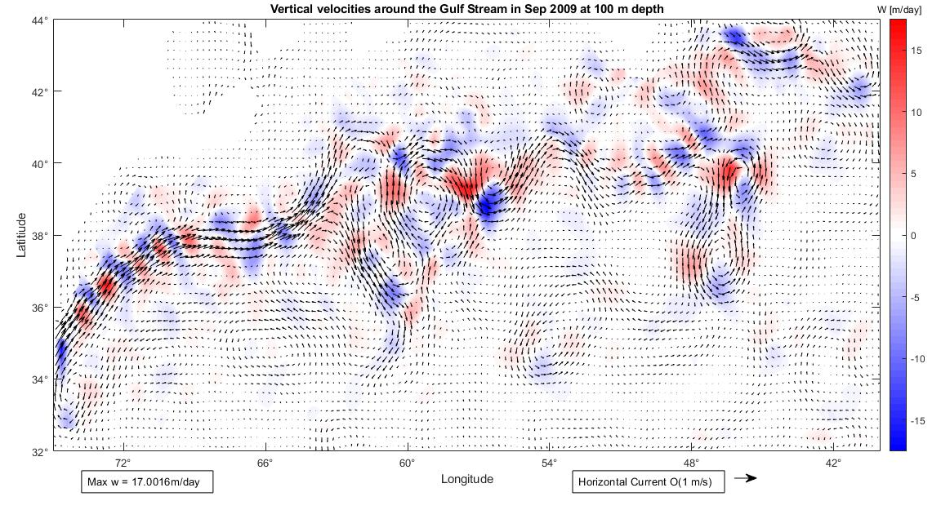
Preliminary Output
Notes:
Three main features in this plot:
Black arrows which indicate horizontal currents
The Gulf Stream that I mentioned earlier
The horizontal currents around the stream are of order 1 m/s
Top right is the East Coast
Red patterns are upward velocities
Blue patterns are downward velocities
-

Slide 11
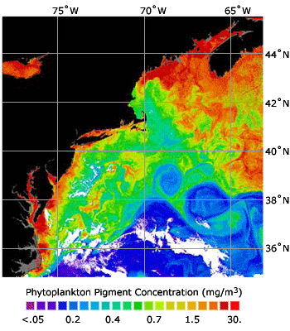
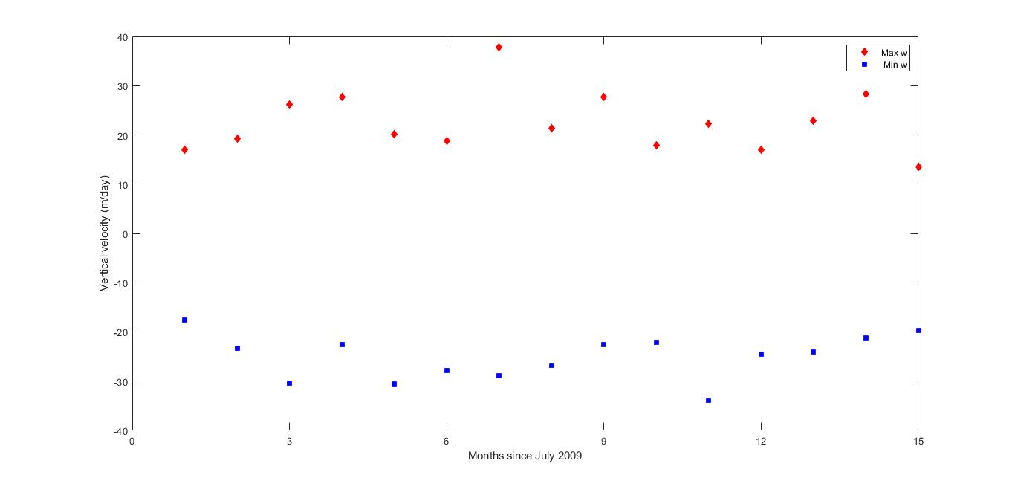
What’s Next?
Map of chlorophyll around the Gulf Stream
W min and max for a 15 month period
Notes:
Plot of chlorophyll at the Gulf Stream which indicate phytoplankton presence
Find correlations between vertical velocities and chlorophyll
I am interested in seeing if there is any seasonal pattern, so
Preliminary plot showing minimum and maximum vertical velocities in the region for a 15 month period
Want to train a supervised regression model that takes u, v, w, T and S as an input and returns chlorophyll as an output

Slide 12
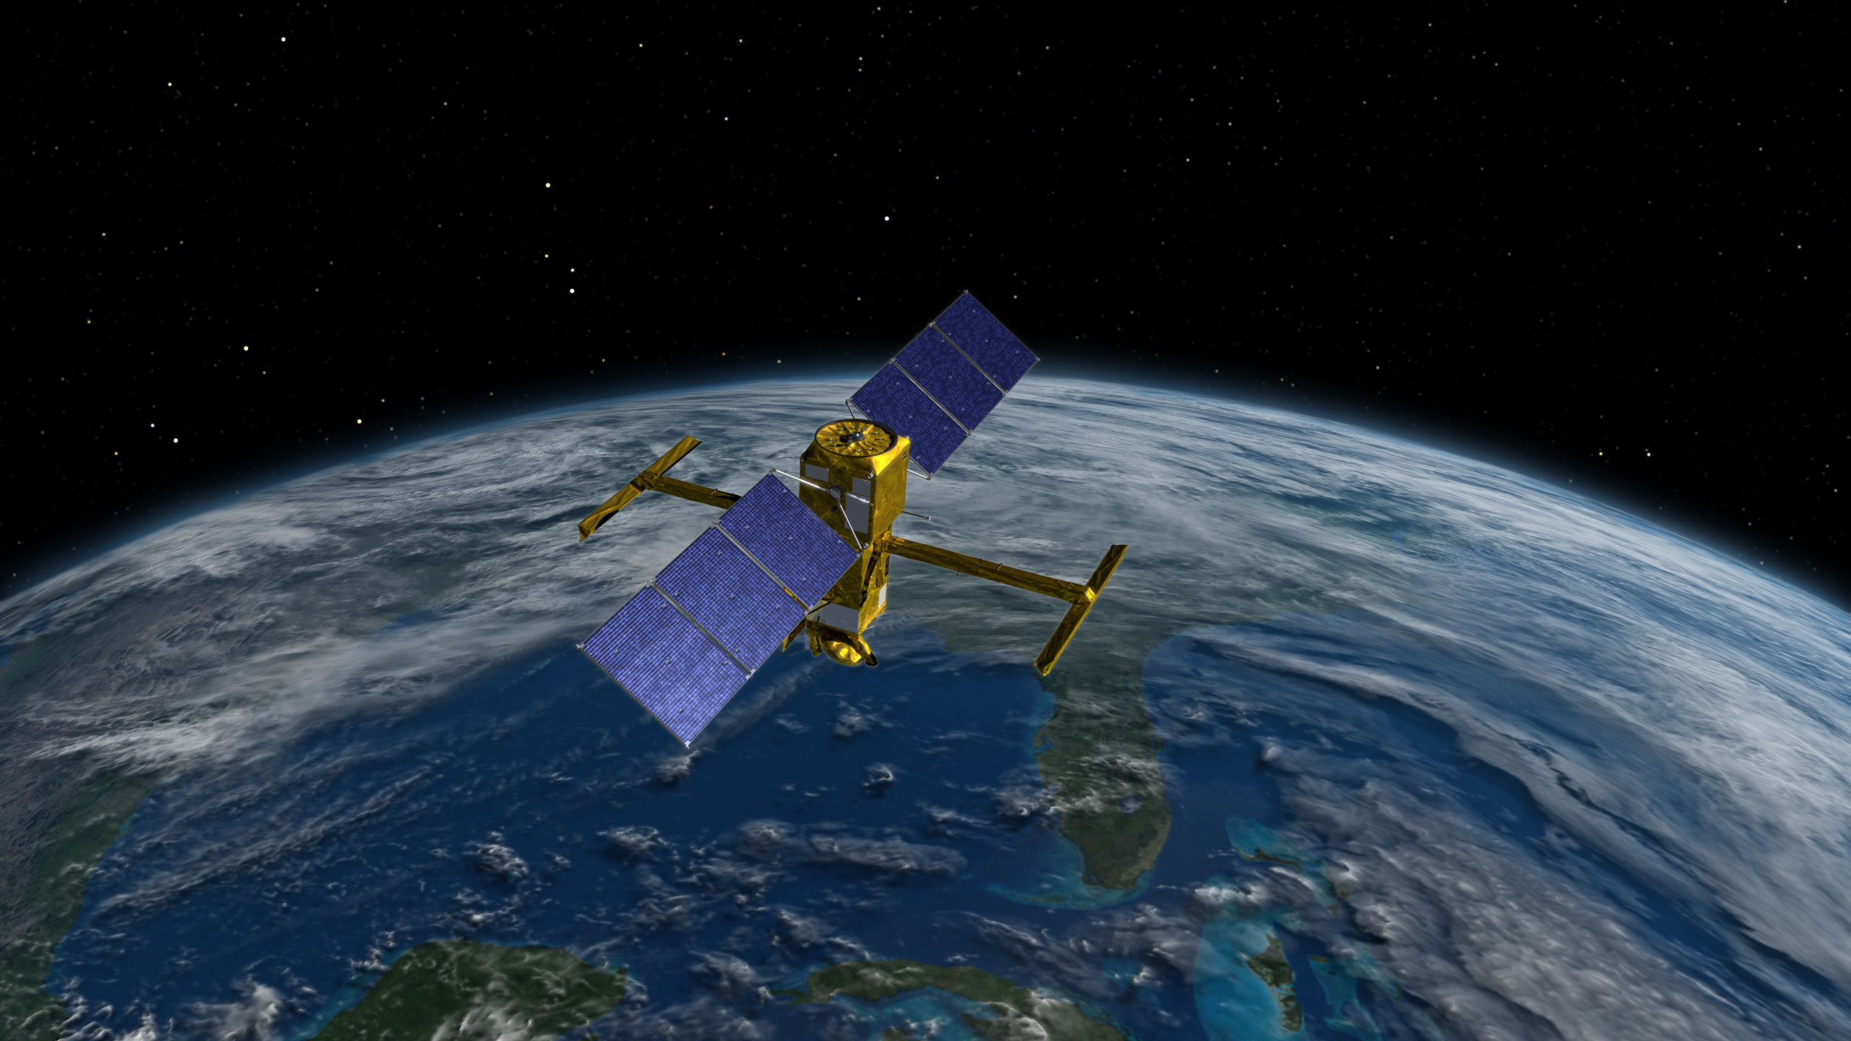
Bigger Picture
Mesoscale and sub-mesoscale vertical velocities is a hot research topic
Most important dynamic factors for phytoplankton productivity is still an open question
They are also important for transport of heat and chemicals
NASA’s SWOT Mission launches in 2020

Slide 13
Acknowledgements
Professor Francois Primeau for posing the research question and guidance
UROP for Fall 2017 – Spring 2018 Fellowship/Grant
Greg Britten for general oceanography advice
Benoit Pascual for MATLAB help
TEOS-10 for the Gibbs-SeaWater (GSW) Oceanographic Toolbox
E.U. Copernicus Marine Service for the data

Slide 14
References
A. Mahadevan. The impact of submesoscale physics on primary productivity of plankton. Annual Review of Marine Science, 8(1):161–184, 2016. PMID: 26394203.B.
A. Pascual, S. Ruiz, B. B. Nardelli, S. Guinehut, D. Iudicone, and J. Tintore. Net primary production in the gulf stream sustained by quasi-geostrophic vertical exchanges. Geophysical Research Letters, 42(2):441{449.
H. Giordani, L. Prieur, and G. Caniaux. Advanced insights into sources of vertical velocity in the ocean. Ocean Dynamics, 56(5):513{524, Dec 2006.
J. Hoskins, I. Draghici, and H. C. Davies. A new look at the w-equation. Quarterly Journal of the Royal Meteorological Society, 104(439):31{38.
J.-M. Pinot, J. Tintor´e, and D.-P. Wang. A study of the omega equation for diagnosing vertical motions at ocean fronts. Journal of Marine Research, 54(2):239– 259, 1996.
J. R. Holton and G. J. Hakim. An introduction to dynamic meteorology. Elsevier, 5 edition, 2013.
Pollard, R.T. and L.A. Regier, 1992: Vorticity and Vertical Circulation at an Ocean Front. J. Phys. Oceanogr., 22, 609–625,

